Slide 1
Sustainable Purchasing with Biobased Products Ron Buckhalt
Notes:
Hello, My name is Ron Buckhalt. I am the former Manager of the USDA BioPreferred Program and now support the Program under contract with Integrated Management Strategies.
With me today, I have Liz Lewis, who is our chat moderator and will help with answering questions.
We have left plenty of time for questions, so we welcome your thoughts. If the purchase card holders you manage have particular buying areas of emphasis, tell us that in the chat and we will try to address specific buying areas.

Slide 2
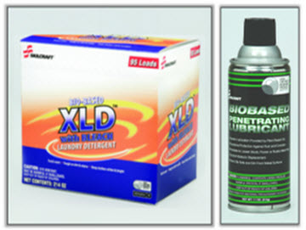
Course Objectives
After completing this course, you will be able to:
Discuss the statutory basis for purchase and fleet card holders to give preference to biobased products.
Describe the positive effects of the use of biobased products on the planet, home, workplace, and U.S. economy.
Explain to purchase card holders how to conduct market research to purchase biobased products.
Inform purchase card holders on methods to locate biobased products in retail stores and online catalogs.
Be proactive in encouraging purchase card holders to purchase and use biobased products.
Biobased Products Available Through AbilityOne
Notes:
Most people only remember three things about a speech or other presentation. Let’s make it simple. First you will learn what a biobased product is, why you should purchase biobased products, and resources for locating biobased products.

Slide 3

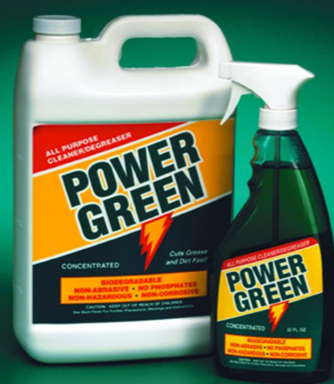
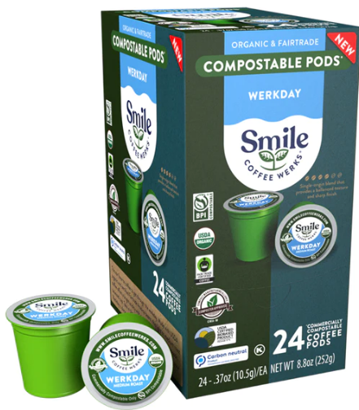
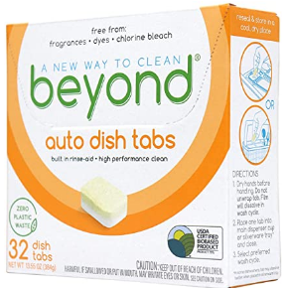
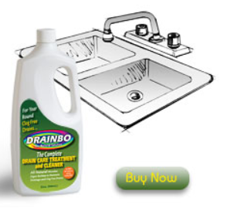
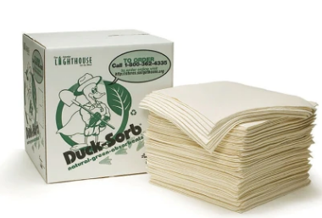
What Is a Biobased Product?
A product composed of renewable biological components - agricultural, forestry, marine materials, and chemicals
Legislative definition for biobased products does not include food, feed, or fuel.
Biobased Binders
Skilcraft Biobased Cleaner
DuckSorb® sorbents offered through AbilityOne
Biobased Dishwashing Pods
Biobased Coffee Pods
Biobased Drain Cleaner
91% biobased
Notes:
The definition of a biobased product is a product composed of recent biological components - agricultural, forestry, and marine materials.
The legislative definition for biobased products does NOT include food, feed, or fuel.
Mention each product on screen. Biobased binders from EarthChoice, Skilcraft cleaners available through AbilityOne, Beyond Dishwashing Tablets are 75% biobased from a company in Wisconsin. SMILE Coffee pods from a Connecticut company. The pods and the packaging for the pods are biobased. Drainbo,out of California, makes a series of biobased drain cleaners and treatments for septic systems. Ducksorb, out of California, makes a series of various types of sorbents for spills.

Slide 4
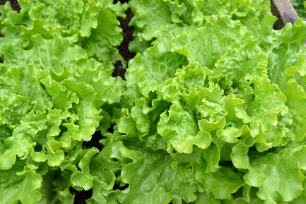
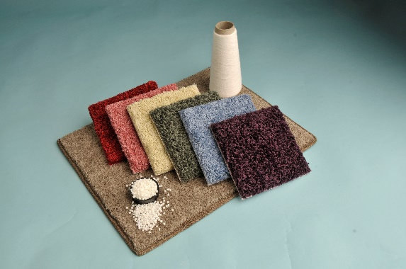
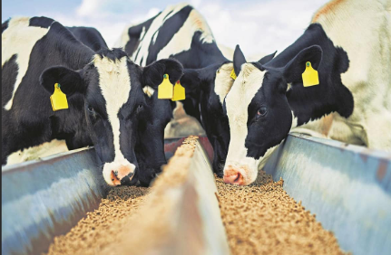


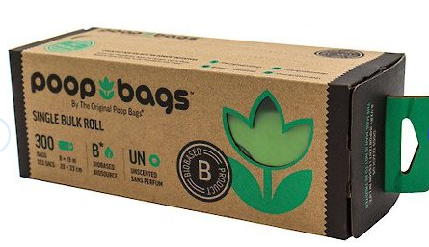
Which of these could be biobased products?
Enter your answers in chat box
1.
2.
3.
4.
5.
6.
Notes:
Since food and feed are not included in the Program, 1 and 3 are not considered biobased products. 2 is a carpet with biobased backing. In 4, the plants are not considered a biobased product, but the pots are biobased. Poop bags are biobased as is the Bioserie toy stacker.

Slide 5

The BioPreferred® Program
Managed by U.S. Department of Agriculture (within Rural Development)
Established by the 2002 Farm Bill
Identifies and seeks new markets for biobased products
Two major program elements
Federal Purchasing Preference
Voluntary Labeling Program
Notes:
In the 2002 Farm Bill Congress once again addressed the cyclical nature of agriculture and created the BioPreferred Program. The goals included helping develop new markets for agricultural commodities by harnessing the purchasing power of the federal government through the federal procurement preference for biobased products. Congress also put in place a voluntary labeling initiative to identify biobased products thus encouraging purchasers to buy USDA Certified Biobased Products. Consumer demand is being driven by the desire to buy and use renewable, environmentally friendly products

Slide 6
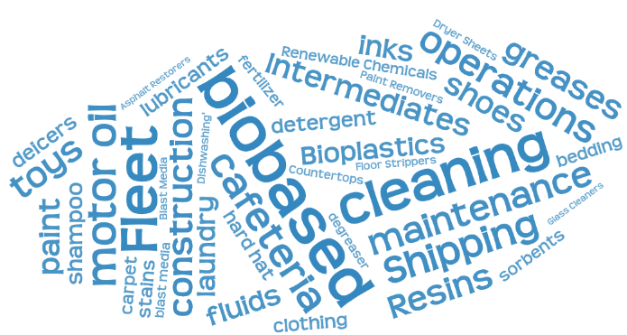
Federal Purchasing
Federal agencies and federal contractors required to buy biobased products in categories designated by USDA
Currently, 139 diverse categories including cleaning products, motor oils, lubricants, and adhesives
About 7900 products in BioPreferred Program catalog that qualify for preferred federal purchasing
Applies to purchase card purchases
Notes:
Federal agencies and their contractors are required to give preference to biobased products in categories designated by USDA. To date, the BioPreferred Program has designated 139 categories of products for a preferred purchasing. The wordle to the right indicates a few of the buying area and categories included in the purchasing preference. The list of designated categories is available on the USDA BioPreferred Program website.

Slide 7
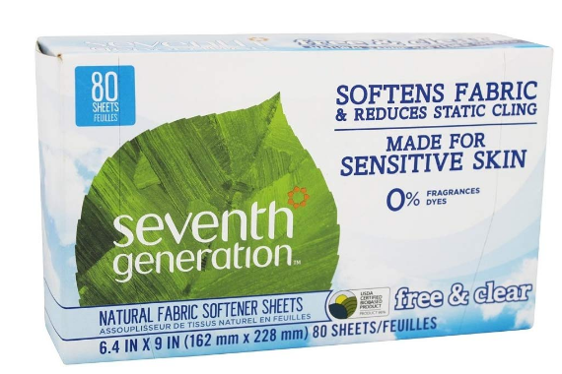

USDA Certified Biobased Product Label
Companies may apply to have their product tested and certified to help in locating biobased products.
Indicates that this product is 97% biobased
FP indicates product qualifies for preferred federal purchasing
Notes:
Note that the actual biobased content of the product is listed on the label.
And the fp indicates the product qualifies for federal purchasing.
Seventh Generation, a company dedicated to sustainability, has over 50 products in the Program, most of them USDA Certified Biobased Products.
Purchase card holders may find this label helpful in identifying biobased products and ensuring the product qualifies for federal purchasing.

Slide 8
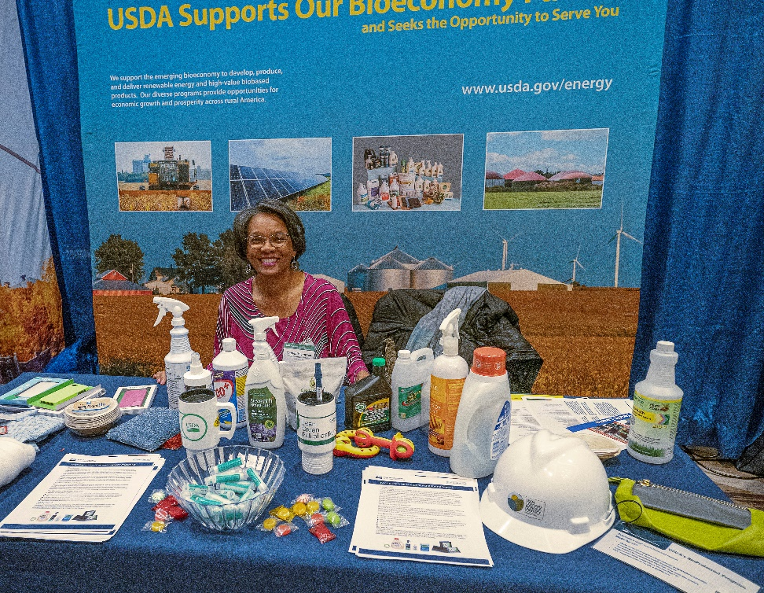
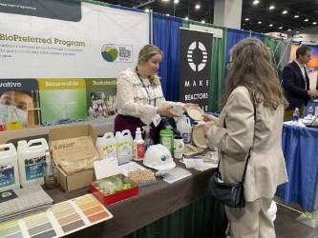
Why is Biobased Product Purchasing Important?
Priority for this Administration
Good for U.S. economy and jobs
Good for the environment
Good for health and safety
Drives U.S. Innovation
BioPreferred Team exhibiting at various conferences
Notes:
Why has this Program received bipartisan support since 2002 and been expanded in subsequent Farm Bills? Well, biobased products purchasing provides demonstrable benefits to the U.S. economy and U.S. jobs. These products also provide benefits to the environment and to home and workplace safety. In addition, biobased products encourage innovation.

Slide 9
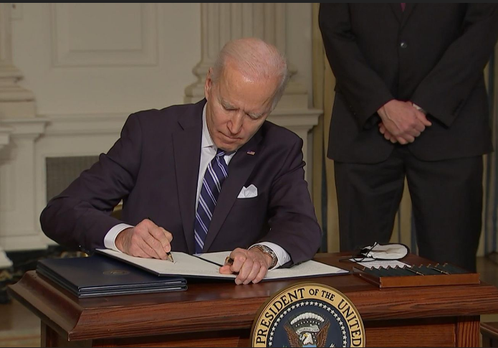
Administration Emphasis Includes New Executive Orders
Executive Order 14057 Catalyzing Clean Energy Industries and Jobs Through Federal Sustainability
Executive Order 14081 Advancing Biotechnology and Biomanufacturing Innovation: Modernizing Regulation Under the Coordinated Framework
Notes:
EO 14057 emphasizes the importance of sustainable acquisition including the federal procurement preference for biobased products.
EO 14081 requires all purchase card holders to complete training on the purchasing preference for biobased products and involves multiple federal agencies in advancing biotechnology and biomanufacturing. E.O. 14081 also expands the reporting of federal purchasing of biobased products, increasing accountability.
Since 2002 the USDA BioPreferred Program has received bipartisan support from Congress which continue to grow the Program as new Farm Bills are passed. There wshould be another new Farm Bill this year.

Slide 10
Biobased Products Benefit the U.S. Economy
The Number of People Employed
4.6 Million
in the U.S. Biobased Products Industry in 2017
Value added Contribution to the U.S. Economy
$470 Billion
from the U.S. Biobased Products Industry in 2017
The Jobs Multiplier
2.79
For every 1 Biobased Product industry job, 1.79 more jobs are supported in the United States
Daystar, J., Handfield, R.B., Pascual-Gonzalez, J., McConnell, E. and J.S. Golden (2020). An Economic Impact Analysis of the U.S. Biobased Products Industry: 2019 Update
Notes:
Cover stats on screen
A new economic study underway. We hope to have updated statistics early next year and determine the impacts of numerous impacts such as COVID, supply chain issues, and fluctuating oil prices which impact the cost of petroleum-based products vs. their biobased product equivalents.

Slide 11

Biobased Companies in 49 States
Over 2100 companies participate in the BioPreferred Program
Products registered in catalog from 49 states – from multi-national companies to small businesses
7900 products in catalog qualify for federal purchasing
6800 products have received the USDA Certified Biobased Product Label
52 countries have products in catalog
As of 1_1_2023
Notes:
Discuss numbers on the screen
Mention that this is the 20th anniversary of the Program

Slide 12
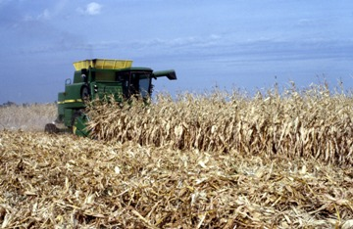
Good for the Farmer and Rural America
New markets for farm commodities
New uses for fibers after food harvest
Helps to stabilize markets for farmers
New manufacturing close to the farm gate
Products from agricultural waste
Notes:
The BioPreferred Program is part of USDA’s Rural Development agency as it supports successful farms and farmers. One way we support the critical food supply is creating new markets for agricultural waste. For example, after the corn has been harvested, the corn stalks, high in fiber, can be used to create new biobased products. By ensuring that farmers are able to have multiple markets for their products, we help to ensure that farmers thrive and that our food supply meets our needs. And often, biobased products are manufactured near the source of the agricultural materials used to make the products creating jobs in rural America.

Slide 13
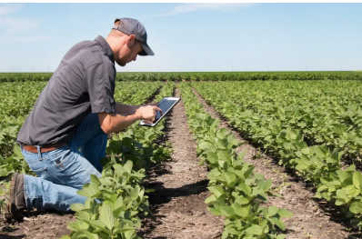
Good for the Environment
Plants sequester carbon in the soil, removing CO2 from the atmosphere.
Notes:
Plants have the potential to save the planet through the process of photosynthesis removing carbon dioxide from the atmosphere, reversing the build-up from burning fossil fuels which is causing climate heating.
Soils and the plants that grow in them absorb about a third of the carbon emissions that drive the climate crisis, partly limiting the impact of fossil-fuel burning.
It is logical then, that products made from plants help the CO2 levels in atmosphere particularly when compared to their fossil-fuel equivalents which increase harmful emissions.

Slide 14
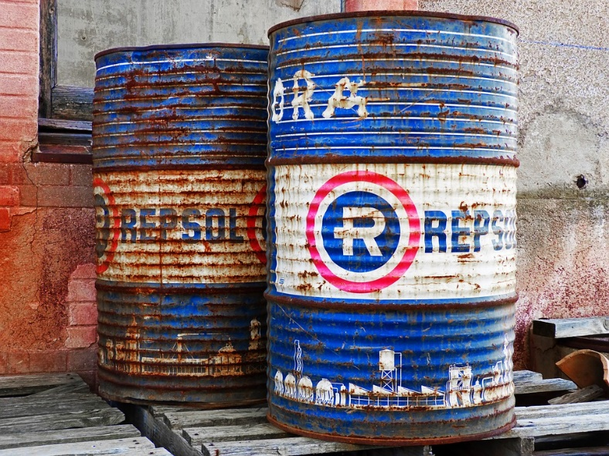
Environmental Benefits of Biobased Products
Petroleum avoided by using biobased products amounts to a savings up to 9.4 million barrels of oil annually. Equivalent of taking 200,000 cars off the road.
An Economic Impact Analysis of the U.S. Biobased Products Industry: 2019
With proper disposal after use, biobased products could offer more than 65% Greenhouse Gas emissions savings.
European Commission, Directorate-General for Research and Innovation, Environmental impact assessments of innovative bio-based products : summary of methodology and conclusions, Publications Office, 2019
Notes:
Cover two examples on screen. Mention this information from the PBPC
Plant-Based Products Council (PBPC) complex equation involved:
Carbon dioxide: Biobased alternatives are made from plants, which remove existing carbon from the atmosphere and decrease the overall levels of carbon in the atmosphere. Energy: The production of biobased feedstocks requires only the sun’s energy. And once harvested, manufacturers of biobased alternatives can sometimes generate their own power using carbon-neutral biofuels. Fossil fuel extraction and petrochemical production often utilize fossil fuels to power their operations. Water: Producers of biobased products are also constantly working to reduce water use. Meanwhile, many fossil fuel-based products are made using natural gas, which is extracted through fracking, a controversial and water-intensive process.
End-of-life: About 79 percent of all plastic ever produced is currently in a landfill or the environment. Compare that to most biobased plastics and packaging, which more often than not are either biodegradable or compostable.

Slide 15
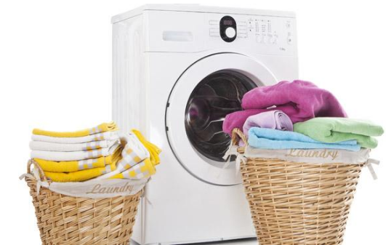
Biobased Products in the Environment
Biobased enzymes in laundry detergent allow cold water wash and can reduce energy costs by 30%.
Biobased de-icers may replace salt-based de-icers, which are harmful to plants and wildlife.
Biobased plasticizers may replace harmful BPA in disposable plastics.
Biobased agricultural waste and bacteria are being used to create chemical-free fertilizers.
Notes:
Discuss the information on the screen.
About biobased plasticizers
A couple of years ago, we heard a lot about the dangers of microwaving plastics due to BPA toxicity. Biobased plasticizers are replacing the BPA in microwavable plastics and are generally made from soybean oil, castor oil, cardanol, and citrate.
About biobased fertilizers
The use of biological waste is a practical solution to recover valuable fertilizer components. In order to effectively implement technologies based on biological resources, it is necessary to recover waste at the farm, which will solve the problem of waste transport or sanitary hazards.

Slide 16

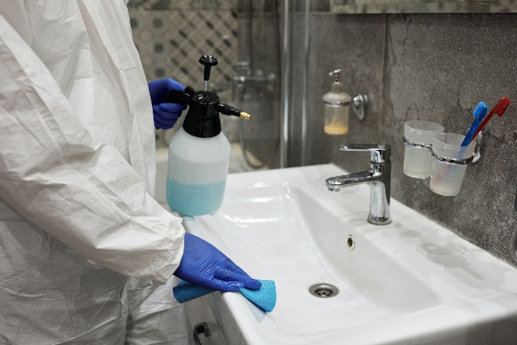
Health and Safety
The EPA Janitorial Products Pollution Prevention Project indicates a single custodial worker uses 194 lbs. of chemicals annually, approximately 25% of which are hazardous substances.
The USDA Office of Operations switched to requiring biobased products in janitorial contracts and found there were:
fewer sick days for cleaning staff
fewer rashes and breathing issues for cleaning staff
positive response from building occupants
Notes:
The EPA study identified the need to decrease the use of hazardous substances in cleaning. When USDA switched to biobased products and conducted a study of the results, they found that there were fewer sick days for cleaning staff, fewer rashes and breathing issues for cleaning staff, and a positive response from building occupants.

Slide 17
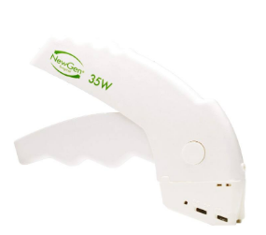

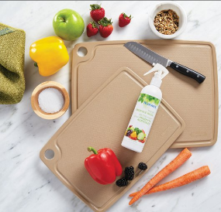
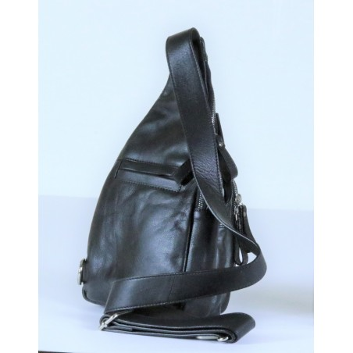

Biobased Products Encourage Innovation
NewGen Surgical™ has 5 biobased surgical products that have earned the USDA Certified Biobased Product Label (California)
Norwex USA, Inc. cutting board from rice husk waste (Texas)
Baron Leather “Pure” products are a biobased leather alternative (Georgia)
Vgard® helmets and hardhats from sugarcane
(Pennsylvania)
Sinomax-USA memory foam products from bamboo and soy (Texas)
Notes:
The creation of new products encourages innovation. Innovation may include product composition such as use of pineapple husks and other agricultural waste, innovative processes also include elements such as growing cycle, energy use in production, and other more sustainable practices used in creating these products. Discuss these products all manufactured in the US and mention Buy American.
Newgen – California; Norwex – Texas; Baron Leather – Georgia; Vgard – Pennsylvania; Sinomax – Texas (mention Made in US)

Slide 18
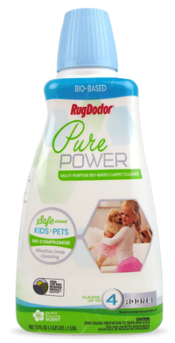
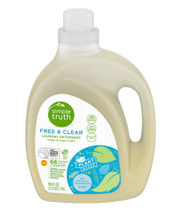
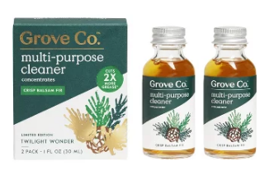
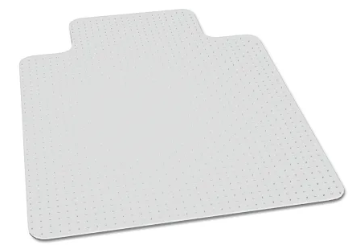
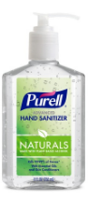
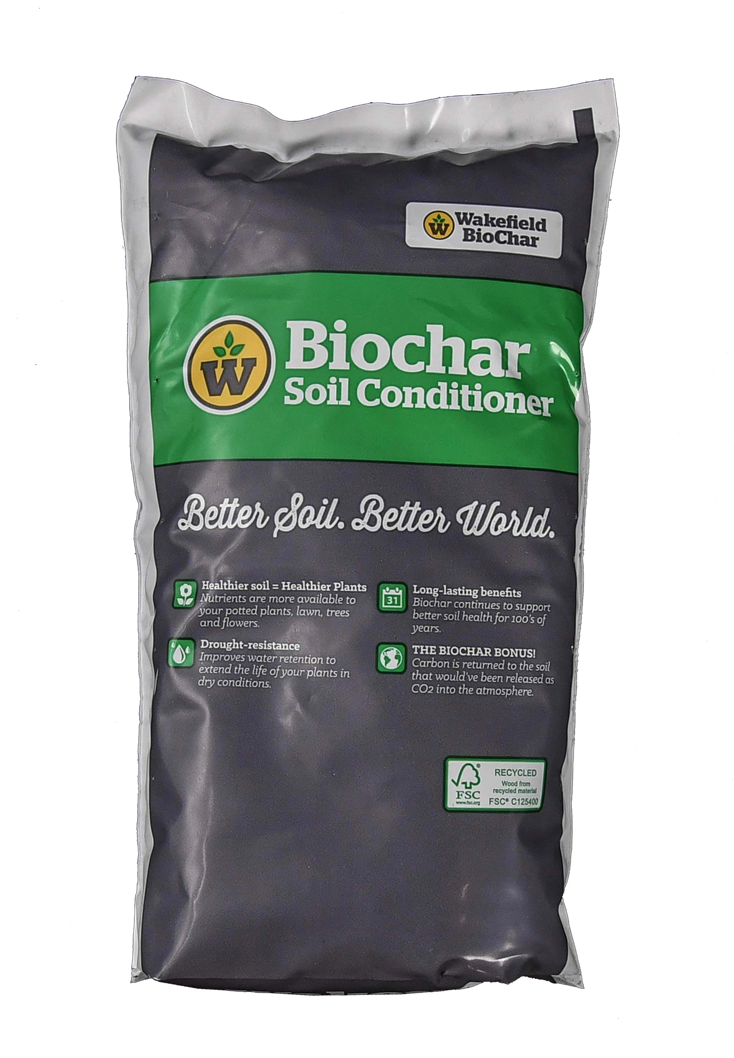

Purchasing Biobased Products: Retail Stores
Multi-Purpose Cleaner - Target
Laundry Detergent
Kroger
Carpet Cleaner Walmart
Skilcraft® Products Office Depot
Soil Conditioner
Lowes
Hand Sanitizer CVS
Coffee Filters
Whole Foods
Notes:
Rug Doctor has 7 USDA Certified Biobased Products – for both home and industrial uses. Grove Collaborative has many USDA certified Biobased Products several of which are available from Target. There are several Skilcraft products available at Office Depot that are biobased. Kroger offers a private label (Simple Choice) biobased laundry detergent. Lowes offers a biochar Soil Conditioner, Purell biobased Hand Sanitizer is widely available including CVS.

Slide 19
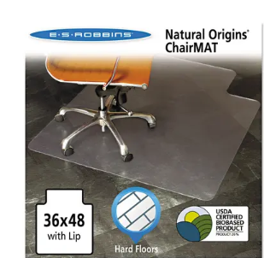
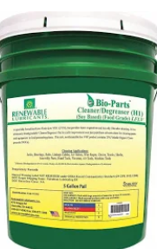
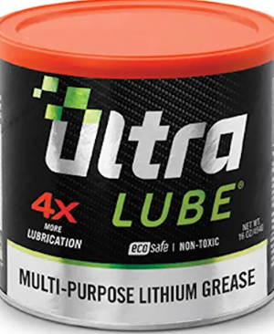
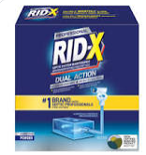
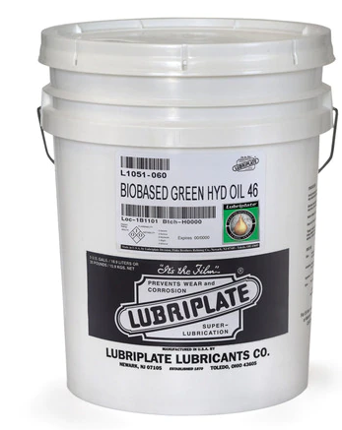
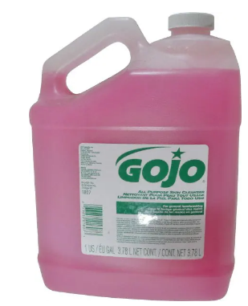
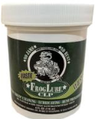
Purchasing Biobased Products in Online Catalogs
Degreaser
Grainger Industrial Supply
Lithium Grease
Amazon
Chair Mat
Overstock
Rid-X
Ebay
Hydraulic Fluid
Zoro
GOJO Hand Cleaner
MSC Industrial Supplies
Firearm Cleaners
Walmart
Notes:
Discuss the products on the screen emphasizing the increased use of commercial catalogs for ordering supplies

Slide 20
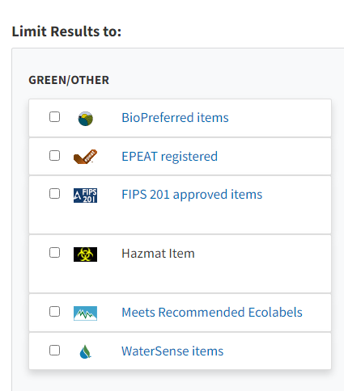
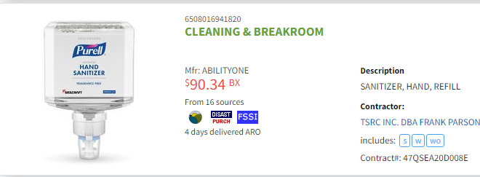
Purchasing Biobased Products: GSA Advantage!®
Use Advanced Search
Click on BioPreferred Items
Notes:
GSAAdvantage offers what they refer to as an environmental aisle. You can limit your search to biobased products by checking the BioPreferred Items box.
In this example, the customer is seeking biobased hand sanitizers.

Slide 21
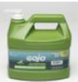
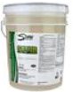
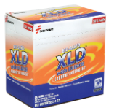

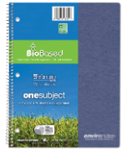
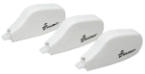
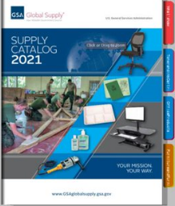

Purchasing Biobased Products: Federal Sources
Hand Cleaner and Drain Maintenance
GSA Advantage!®
Biobased Products also available through FedMall and GSA Global Supply™
Laundry Detergent, Correction Tape, Binders
AbilityOne
Notes:
As I indicated earlier, GSAAdvantage! offers many biobased products for purchase as does Global Supply and DoD’s FedMall. And you can check two boxes by purchasing biobased products from AbilityOne since both are mandatory purchasing programs. AbilityOne provides products that are processed by people with vision issues.

Slide 22

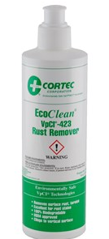
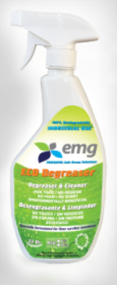
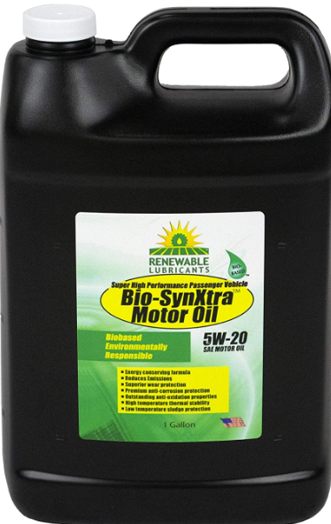
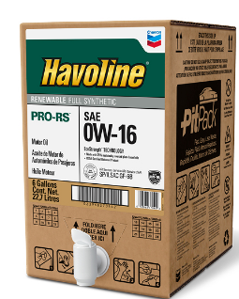
Biobased Products for Fleet Use
Motor Oils
Degreasers
Rust Remover
Lubricants
Notes:
There are many biobased products for fleet. Here we see two types of motor oils, a rust remover, a lubricant, and a degreaser. There are other products such as automotive cleaning products as well.
DoD’s Sustainable Products Center tested biobased motor oils. “The biobased engine oils met the identified performance requirements in the demonstration vehicles with no reported vehicle engine operation or performance issues. The performance of the biobased motor oils was comparable to full synthetic petroleum-based motor oils used in the baseline demonstration vehicles”

Slide 23
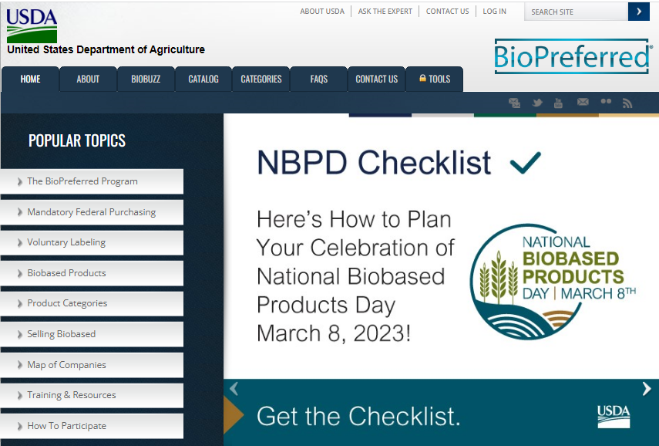
The BioPreferred Program Website
Notes:
Note that there is now a National Biobased Products Day and events took place this year across many companies and associations. The 2023 event included…… It is an annual event, so going forward…..
Note also that there is a tab to access the 139 categories of products for which there is a purchasing preference. And I have mentioned our catalog.
This is the home page of our website at www.biopreferred.gov. There are many resources including lists of designated products categories, the catalog, and other resources.

Slide 24
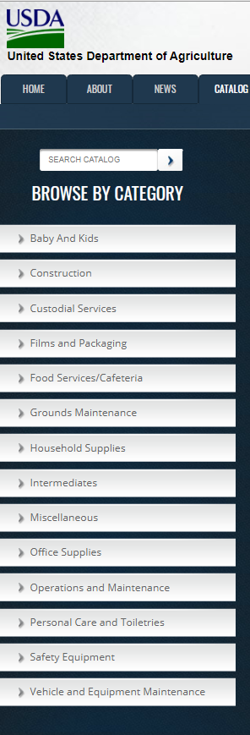
Catalog for Market Research
BioPreferred Program Catalog www.biopreferred.gov
Product description
Company website
Biobased content
Notes:
The BioPreferred Program Catalog is a resource for locating biobased products. You cannot purchase products directly from this catalog, but it provides product information, company information, the biobased content of the product, and website and other contact information. You can use the menu on your screen or the open-ended search function.

Slide 25

Sample Product Listing
Notes:
This particular catalog entry is for a hydraulic fluid. Manufacturers can include in their descriptions things like standards that they meet (ASTM), NSN, availability through federal supply catalogs, absence of intentionally added PFAS, and whether the product qualifies for Buy American

Slide 26

Stay Current with BiobuzzGov Newsletter
Notes:
We have a newsletter that targets federal government employees. You can sign up to receive this newsletter on our website. You can also view archived editions.

Slide 27
Quiz
Why am I required to use my purchase card to buy biobased products?
a. the Federal Acquisition Regulation
b. the 2002 Farm Bill
c. there are no requirements for purchase card holders
d. the Federal Acquisition Regulation and the 2002 Farm Bill
Enter your answer in chat box

Slide 28
Quiz
Where can biobased products be found and purchased?
a. local hardware stores
b. the USDA BioPreferred Program Catalog
c. Online retailers such as Amazon or Grainger
d. All of the above
Enter your answer in chat box

Slide 29

Quiz
Is this product in a category designated for federal purchasing?
a. Yes
b. No
c. Cannot Tell
Enter your answer in chat box
Notes:
The FP indicates that the product qualifies for federal purchasing.

Slide 30

The Future?
Thales makes a biobased payment card that has earned the USDA Certified Biobased Product Label.
The card is 78% biobased.
Maybe a biobased Federal charge card in the future?
Notes:
There are now biobased payment cards available. This particular one is a USDA Certified Biobased Product and is 78% biobased. Perhaps the purchase and fleet cards of the future will be biobased.

Slide 31

You Play an Important Role
Purchase biobased products
- at work
- at home
Educate your purchase card holders!
Together we support:
the U.S. economy
U.S. jobs
farmers and rural America
a healthy planet
Examples of biobased products BioPreferred Program team uses in their homes.
Notes:
We did a little exercise in our Program where we asked staff to provide photos of biobased products they used at home. These are a few of the photos. We love using these products. We hope that you will choose biobased products to use at work and in your home.

Slide 32

GSA Starmark Logo

